Slide 1
Arduino Target Processor (ATmega 328)

Slide 2
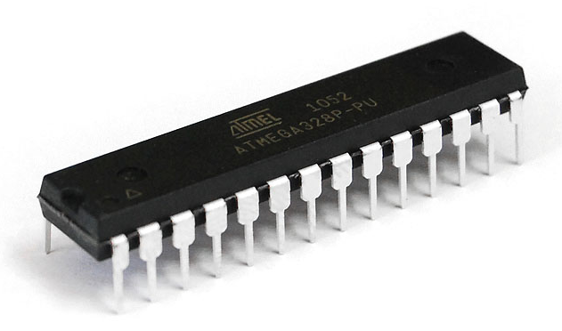
Physical structure

Slide 3
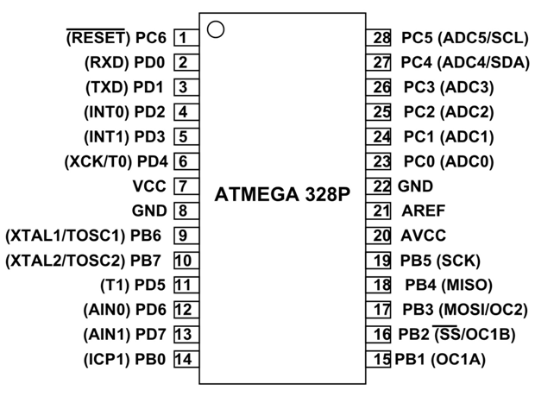
Pinout Diagram

Slide 4
The ATmega328 is a low-power CMOS 8-bit microcontroller based on AVR enhanced RISC (Reduced Instruction Set Computer) architecture.
In order to maximize performance and parallelism, it uses Harvard architecture.
It belongs to AVR family of microcontrollers.
AVR stands for Advanced Virtual RISC (RISC stands for Reduced Instructions Set Computers).
AVRs executes most of the instructions in single execution cycle, They consume less power and they can be designed to operate in different power saving modes.

Slide 5
ATMEGA 328 ARCHITECTURE
Simply, Arduino's processor uses the Harvard architecture where the program code and program data have separate memory.
It consists of two memory namely Flash memory (program memory) and Data memory.
The code is stored in the flash memory, whereas the data is stored in the data memory.
The Harvard architecture allows more than one memory transaction simultaneously through the use of two memory spaces.

Slide 6
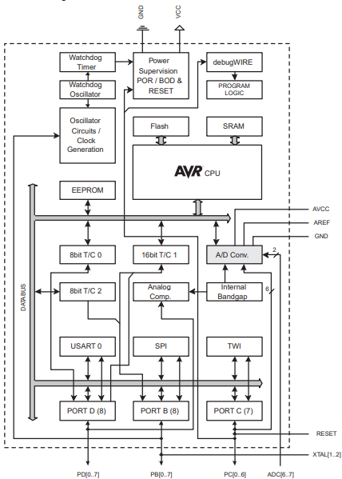

Slide 7
ATMEGA 328 Architecture cont…
In the Harvard architecture the un-occupied data memory cannot be used by instructions and the free instructions cannot be used by data.
Memory dedicated to each unit has to be balanced carefully.
Harvard architecture is primarily for small embedded systems and signal processing.
A Harvard architecture system can be thus faster for a given circuit complexity because instruction fetches and data access do not contend for a single memory pathway.
Also the Harvard architecture has distinct code and data address spaces meaning address zero is not the same as data address zero.

Slide 8
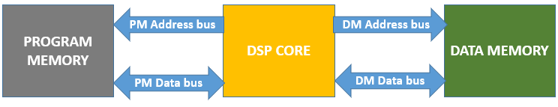
Harvard Architecture block diagram

Slide 9
AVR microcontrollers categories
There are three categories namely TinyAVR, MegaAVR and XMegaAVR
MegaAVR are the most popular ones having good amount of memory (upto 256KB), higher number of inbuilt peripherals and suitable from moderate to complex applications.
The naming convention of the AVR is such that, taking ATmega328, the "AT" stands for ATMEL the manufacturer, the "mega" means that the microcontroller belong to the MegaAVR category and "32" signify the memory of the microcontroller which is 32KB and the "8" signify the system type which is 8-bit

Slide 10
Arduino UNO ATmega328 Features
The operating voltage ranges from 1.8V to 5.5V (normally it operates in a range of 3.3V to 5.5V)
Many arduino boards operate at 5V but some of the newer cards operates at 3.3V.
It is an 8 – bit and 28 pins AVR microcontroller, 32KB of flash memory, 1KB of EEPROM, 2KB of SRAM, 8 pins for ADC operations, 3 built-in timers (2 are 8-bit timers, 1 is a 16-bit timer) and 6 PWM pins.
It has both general purpose registers and special purpose registers.

Slide 11
An electronic register is a form of memory that uses a series of flip flops to store the individual bits of a binary word.
The general purpose registers do not have side effects, they can be used by most instructions. One can do arithmetics with them, use them for memory addresses and so on.
Special purpose registers can only be used for certain purposes and only by certain instructions.
A timer is a control device that outputs a signal at a present time after an input signal is received.
A counter is a device which stores the number of times a particular event or process has occurred (often in relationship to a clock).

Slide 12
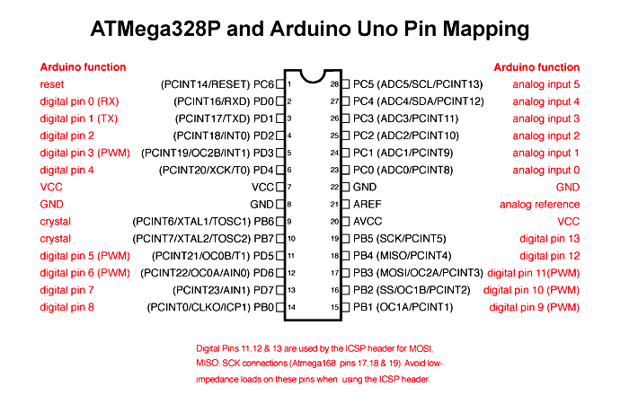

Slide 13


